Slide 1
Dave Networking portfolio Worksample
Example
Systems administration & networking

Slide 2
Career Goal- Systems Administrator
Since my youth I’ve been fascinated by computer systems and security. I’m a self-motivated individual who is an independent learner.
Systems Administrator: They install, upgrade and monitor software & hardware. They usually maintain the essentials such as operating systems, business applications, security tools, web-services, email, PCs, hardware & software for local and wide area networks and mid-range server hardware. (*)
Key Systems Administrator skills include: Networking, Operating System administration, Server Administration, Hardware, Customer Service/Communication, Project Management/Systems Analysis
* Bateman, Kayleigh. (20 Sept 2013). How to become a system administrator. Computer Weekly. Retreived Jan 31/2018 from http://www.computerweekly.com/photostory/2240205822/How-to-become-a-system-administrator/1/System-administrator-Job-description

Slide 3
Skill Area- Networking
Networking is the construction, design, and use of a network, including the physical (cabling, hub, bridge, switch, router, and so forth), the selection and use of telecommunication protocol and computer software for using and managing the network, and the establishment of operation policies and procedures related to the network.*
*Rouse, Margaret. (n.d.). Definition-networking. TechTarget. Retrieved Jan 31/18 from http://searchnetworking.techtarget.com/definition/networking

Slide 4
Work Sample- Network design
Hierarchical networking course
Task: Develop network configurations based on customer requirements. Steps:
Created a Packet Tracer environment in order to create the network.
Analyzed company’s needs to create or expand on the network layout
Performed device configuration based on the requests made by the company.

Slide 5
Prior learning
Essentially I started the program with only a theoretical knowledge of networking concepts.
From a practical standpoint, the most that I had ever accomplished was to follow instructions to set up a wireless router at home.
But a home environment is not the same as a business environment…

Slide 6
Scenario 1: Eastern Health Systems
Scenario 1: Eastern Health Systems
The Eastern Health Systems networking scenario is a business case analysis and network implementation, focused on STP, LACP, Vlan Trunking, and Routing protocols.
Background:
EHS has contracted your company to expand their computer network into a new building, which they have purchased.
Issue:
Since you are joining an existing network, you are expected to adopt the EHS network standards in your design. In cases where there is not a specific EHS requirement you will use industry standard conventions.
Requirements:
The building has a single floor; all of the workspaces may be serviced from one of the two wiring closets. The closets are within 90 meters of each other.
There will be approximately forty (40) workstations in the facility, spread evenly over 4 data networks (NOTE: You must include all 40 workstations in your packet tracer configuration). Switches must be connected to others using the fastest, most reliable method possible.
The contracted ISP will provide a Cisco 2621 router with the ISP interface configured. All building networks must connect to this device (R4). While the ISP interface is configured, the router does belong to EHS and will need to be configured by your company for intra-VLAN routing and DHCP.
Workstation IP addressing will be issued via DHCP, without exceptions for each data network (for instance, VLAN 10's DHCP scope should be within 172.16.10.x. The management network will not use DHCP.

Slide 7
Eastern Health system Standards
EHS Standards (Supports Analysis Level Discussion)
Management VLANs will use VLAN ID 99
Data VLANs will start numbering at 10. VLANs 1-9 and 99 must not carry data
All unused ports in a device (router or switch) will be shut down or assigned to VLAN 1
EHS IP addressing uses the Class B private address range 172.16.0.0/16. All subnets use a 24 bit mask (255.255.255.0)
The third octet of any IP address will match the associated VLAN ID
Every network device will have a UID and password login and be accessible using telnet
A banner will be presented to every user of the device, detailing the device name and location.

Slide 8
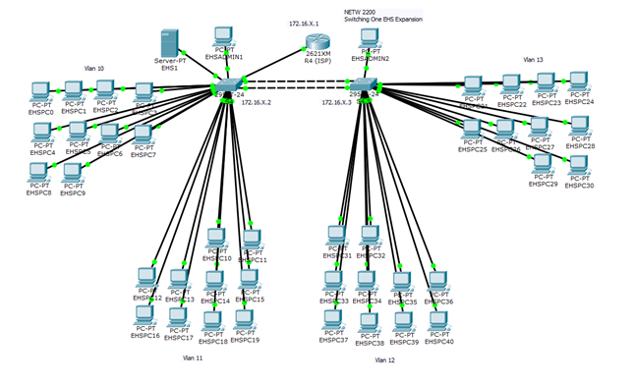
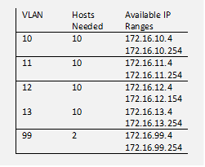
Work Example
Analysis level discussion
VLANS were assigned as shown in table. Note VLSM were not used in this instance.
DCHP was configured via company router.
VTP was enabled to allow Vlan propagation across all routers.

Slide 9
Key Learnings
What technical skills did you use?
Router & Switch Configuration, OSPF Configuration, VLAN & VTP Configuration, SSH Configuration, Inter VLAN routing, RIPv2 Protocol, DHCP Configuration, Router Sub-Interface Configuration, STP & LACP Configuration, Network Design
Show a progression of learning.
With only a theoretical knowledge of networking I was able to design a network that met client needs.
Looking back now, how would you make it better? (ties into Analysis Level Discussion )
After designing the networking I realized that I could improve the security by limiting the number of available IP addresses for each VLANS to 40 rather than the full remaining 250. This would reduce the chance of unauthorized systems getting onto the network.

Slide 10
Business Benefits
Because of the design of the work this shows that I can develop a network which:
Meets client needs
By being more secure
With more functionality
…over the original design

Slide 11
Connection to me
This was a great demonstration of my learning skills!
It also showed my methodical approach to problem solving.
I’ve always been action oriented. This work sample helped me make the transition from the theory of networking to the practical implementation of it within a business environment.
Most importantly, this worksample on network design helped make a direct connection for me about the importance of network security.

